Slide 1
SQL
Joins - Exercises

Slide 2

Query Buildings
1. Get all Items containint ‘set’ as description and unit_price between 500 and 23000.
SELECT *
FROM item
WHERE description LIKE '%set%'
AND unit_price BETWEEN 500 AND 23000;
2. Get amount of carts per ShipTo from Cart with Status other than Created.
SELECT ship_to_id
, COUNT(cart_id) AS carts
FROM cart
WHERE status_id != 1100
GROUP BY ship_to_id;

Slide 3
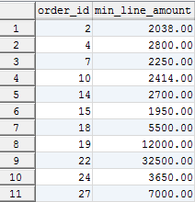

Query Buildings
3. Get the mínimum_line_amount per Order from OrderLines where status_id are among (3100, 3300) and the minumum_line_amount is greater than 1,500.
SELECT order_id
, MIN(line_amount) AS min_line_amount
FROM order_line
WHERE status_id IN (3100, 3300)
GROUP BY order_id
HAVING MIN(line_amount) > 1500
4. Create a report from Orders that includes per payment_method_id the total of orders in each Status. The report has to cosider only Order with dada of 2015.
SELECT payment_method_id
, SUM(IF(status_id=2100,1,0)) AS created
, SUM(IF(status_id=2300,1,0)) AS delivered
, SUM(IF(status_id=2350,1,0)) AS partially_delivered
, SUM(IF(status_id=2400,1,0)) AS canceled
FROM orders
WHERE DATE_FORMAT(order_date,'%Y') = '2015'
GROUP BY payment_method_id

Slide 4
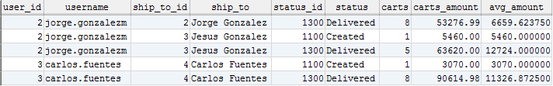
Joins
1. Get the number of carts by ShipTo and Status, from Carts “CREATED” and “DELIVERED” and which the average of cart_amount on each group is between $ 3,000 and $ 15,000.
Include the relevant description for ShipTo and Status.
SELECT c.user_id
, u.username
, c.ship_to_id
, st.name ship_to
, c.status_id
, s.description status
, COUNT(c.cart_id) AS carts
, SUM(c.cart_amount) AS carts_amount
, AVG(c.cart_amount) AS avg_amount
FROM cart c
INNER JOIN user u ON c.user_id = u.user_id
INNER JOIN ship_to st ON c.ship_to_id = st.ship_to_id
INNER JOIN status s ON c.status_id = s.status_id
WHERE c.status_id IN (1100, 1300)
GROUP BY c.ship_to_id, c.status_id
HAVING avg_amount BETWEEN 3000 AND 15000;

Slide 5
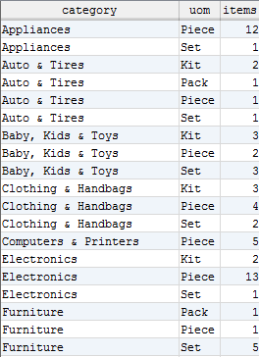
Joins
2. Get the number of Items by Category and UnitOfMeasure.
Sort the result by Category and then by UOM.
SELECT c.description category
, uom.description uom
, COUNT(i.item_id) items
FROM category c
INNER JOIN category_item ci ON c.category_id = ci.category_id
INNER JOIN item i ON ci.item_id = i.item_id
INNER JOIN uom ON i.uom_id = uom.uom_id
GROUP BY category, uom
ORDER BY category, uom;

Slide 6
Jorge Luis Gonzalez
jorge.gonzalezm@softtek.com
Instructor

